Slide 1

EPA’s PFAS Strategic Roadmap:
Commitments to Action 2021-2024
www.epa.gov/pfas

Slide 2
Overview
EPA’s PFAS Strategic Roadmap
Background on Per- and Polyfluoroalkyl Substances (PFAS)
EPA’s Approach and Goals
Key Roadmap Progress and Upcoming Actions
Whole-of-Agency Actions
Bipartisan Infrastructure Law and PFAS

Slide 3
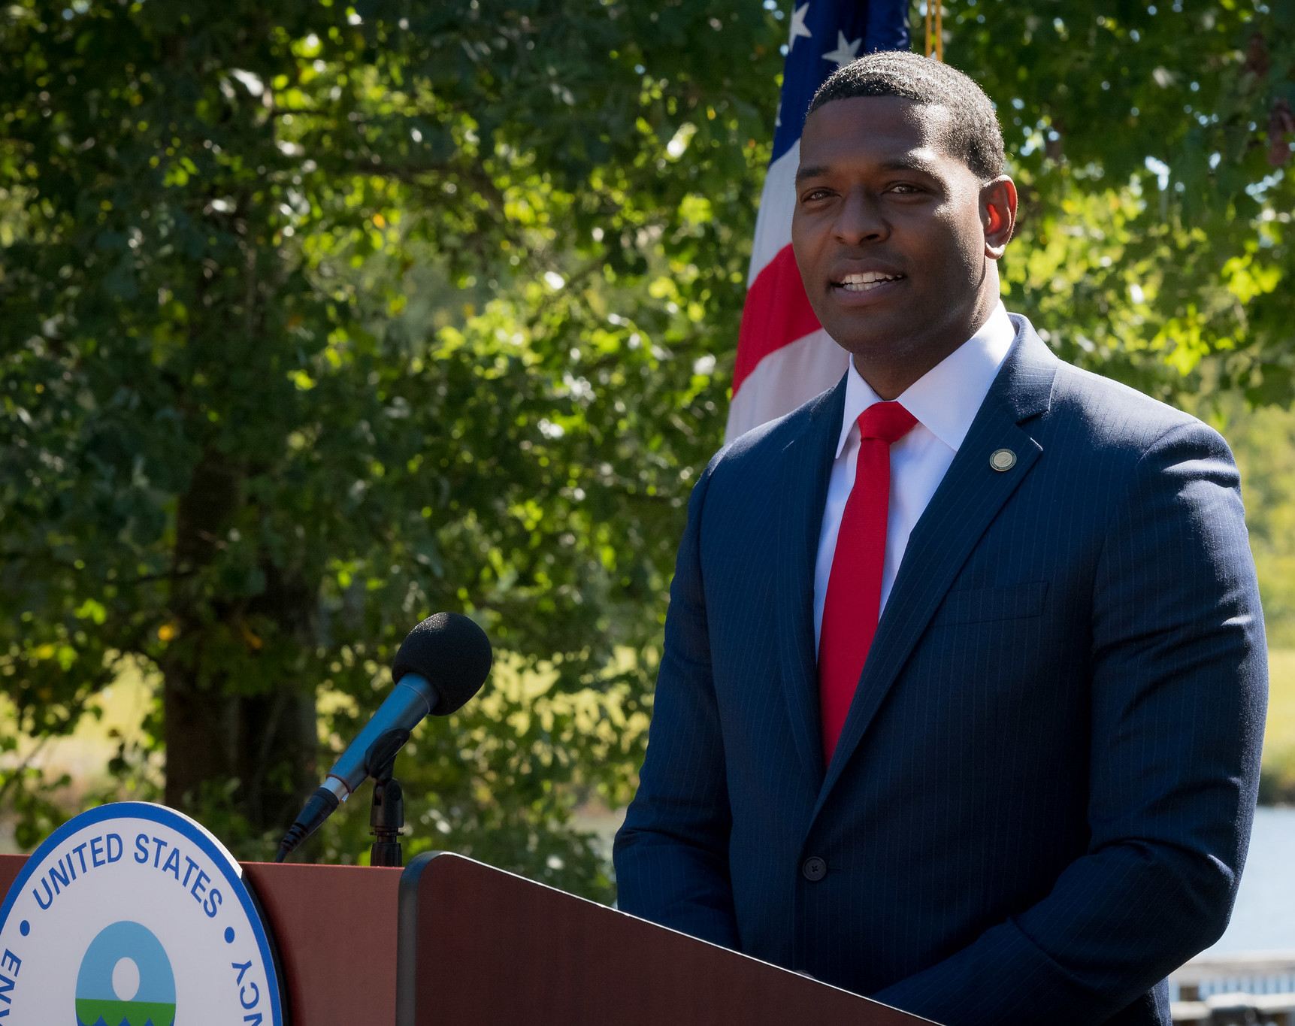
EPA’s PFAS Strategic Roadmap:
Commitments to Action 2021-2024
EPA Administrator Michael Regan established the EPA Council on PFAS in April 2021.
The Council developed the PFAS Strategic Roadmap, released in October 2021 – a bold, strategic, whole-of-EPA approach to protect public health and the environment from PFAS.
The Roadmap:
  Includes timelines for concrete actions from 2021-2024;
  Fills a critical gap in federal leadership;
  Supports states’ ongoing efforts; and
  Builds on the Biden-Harris Administration’s commitment to restore scientific integrity.

Slide 4
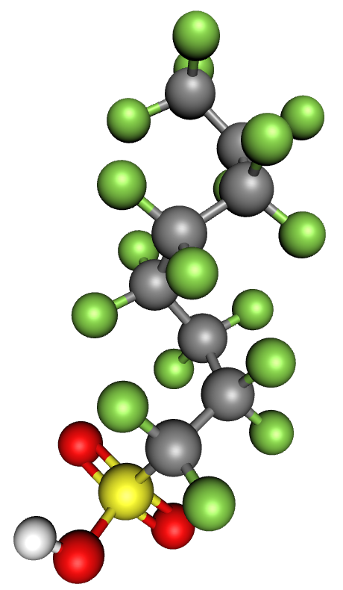
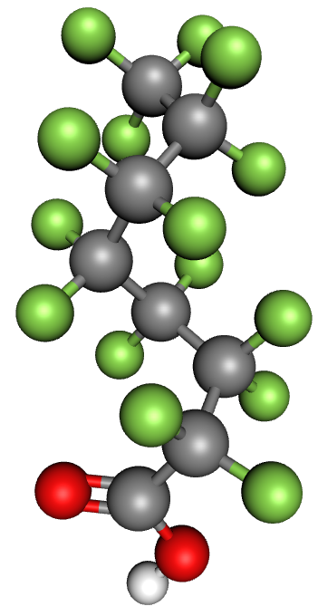
What Are Per- and Polyfluoroalkyl Substances (PFAS) and Why are We Concerned?
PFAS captures a large class of synthetic chemicals.
Chains of carbon atoms surrounded by fluorine atoms.
Wide variety of chemical structures.
Used in homes, businesses, and industry since the 1940s.
Used by a number of industries and found in many consumer products.
Detected in soil, water, fish, and air samples.
Most people have been exposed to PFAS.
Known or suspected toxicity.
Some are relatively well understood; many others are not.
Resist decomposition in the environment and in the human body.
Perfluorooctanoic acid (PFOA)
Perfluorooctanesulfonic acid (PFOS)

Slide 5
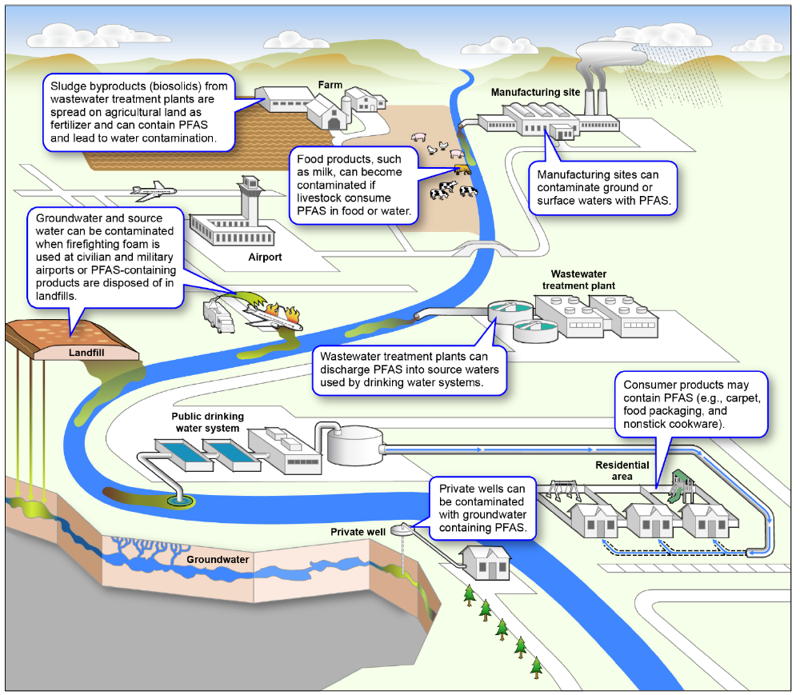
PFAS Lifecycle and EPA’s Approach
EPA’s approach is centered around the following principles:
Consider the Lifecycle of PFAS.
Get Upstream of the Problem.
Hold Polluters Accountable.
Ensure Science-Based Decision-Making.
Prioritize Protection of Disadvantaged Communities.
Source: GAO | GAO-21-37

Slide 6
EPA’s Goals in the Strategic Roadmap
RESEARCH
Invest in research, development, and innovation to increase understanding of
PFAS exposures and toxicities;
Human health and ecological effects; and
Effective interventions that incorporate the best-available science.
RESTRICT
Pursue a comprehensive approach to proactively prevent PFAS from entering air, land, and water at levels that can adversely impact human health and the environment.
REMEDIATE
Broaden and accelerate the cleanup of PFAS contamination to protect human health and ecological systems.

Slide 7
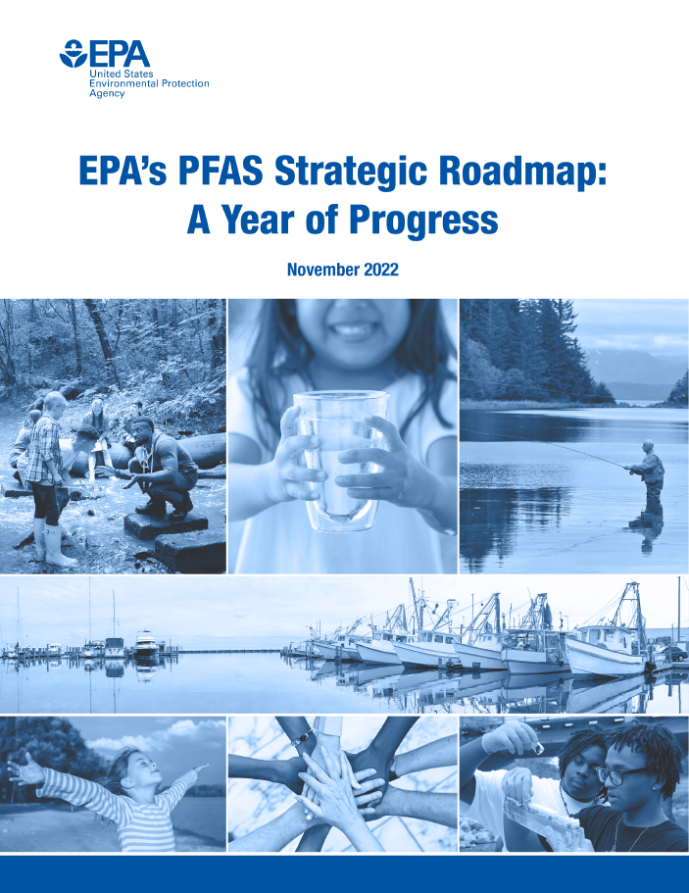
Key EPA PFAS Accomplishments:
(October 2021-present)
Proposed a National Primary Drinking Water Regulation for six PFAS
Proposed to designate PFOA and PFOS as CERCLA hazardous substances
Taken action to restrict PFAS discharges to waterways
Laid the foundation for enhancing PFAS chemical and drinking-water data
Began distributing $10 billion in Bipartisan Infrastructure Law funding to address emerging contaminants in water
Expanded the scientific understanding of PFAS and translated the latest science into EPA’s efforts
Proactively used enforcement tools to identify and address PFAS releases
Engaged with federal partners and the public

Slide 8
Key Roadmap Actions:
Research and Development
Develop and validate methods to detect and measure PFAS
RESEARCH
Advance the science to assess human health and environmental risks
RESEARCH
Evaluate and develop technologies for reducing PFAS in the environment
RESEARCH
REMEDIATE

Slide 9
Key Roadmap Actions:
Ensuring Chemical Safety
Deepen our understanding of PFAS categories through the National PFAS Testing Strategy
RESEARCH
RESTRICT
Strengthen EPA oversight over both new and existing PFAS
RESTRICT
Improve data on PFAS uses and releases
RESEARCH
RESTRICT
Reduce PFAS in federal procurement
RESTRICT

Slide 10
Key Roadmap Actions:
Protecting our Water
Set enforceable limits for PFAS in drinking water
RESTRICT
Improve PFAS drinking-water data through monitoring, toxicity assessments, and health advisories
RESEARCH
Develop technology-based PFAS limits for industrial dischargers
RESTRICT
Address PFAS in Clean Water Act permitting, analytical methods, water quality criteria, and fish advisories
RESEARCH
RESTRICT
Evaluate risks of PFAS in biosolids
RESEARCH

Slide 11
Key Roadmap Actions:
Cleaning Up PFAS Contamination and Addressing PFAS Air Emissions
Develop regulations to designate PFAS as CERCLA hazardous substances
REMEDIATE
Take regulatory action to tackle PFAS under RCRA
REMEDIATE
Update research and guidance on PFAS destruction and disposal
RESEARCH
REMEDIATE
Build the technical foundation for potential Clean Air Act regulation
RESEARCH
RESTRICT

Slide 12
Bipartisan Infrastructure Law and PFAS
The Bipartisan Infrastructure Law makes transformational investments in America’s water infrastructure. It provides $10 billion to invest in communities impacted by PFAS and other emerging contaminants, including:
$4 billion
Drinking Water State Revolving Fund
$1 billion
Clean Water State Revolving Fund
$5 billion
Small or Disadvantaged Communities Drinking-Water Grants

Slide 13
PFAS Strategic Roadmap:
EPA’s Commitments to Action 2021-2024
epa.gov/pfas | PFASCouncil@epa.gov

